Slide 2
Topics
  The Parts of a Java Program
  The System.out.print and System.out.println Methods, and the Java API
  Variables and Literals
  Primitive Data Types
  Arithmetic Operators
  Combined Assignment Operators
  Conversion between Primitive Data Types
  Creating named constants with final

Slide 3
Topics (cont’d.)
  The String class
  Scope
  Comments
  Programming style
  Reading keyboard input
  Dialog boxes
  The System.out.printf method

Slide 4
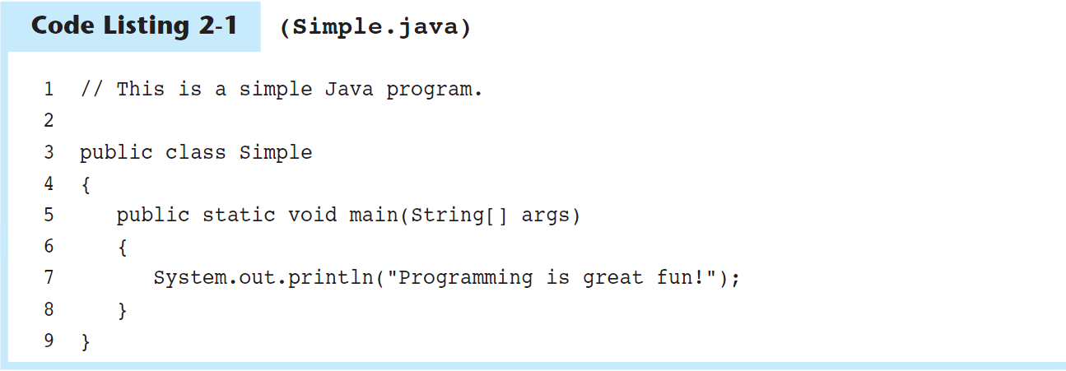
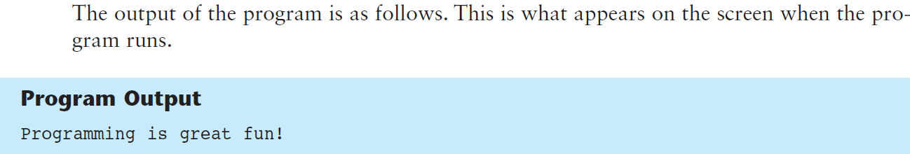
The Parts of a Java Program

Slide 5
The Parts of a Java Program (cont’d.)
To compile the example:
  javac Simple.java
  Notice the .java file extension is needed.
  This will result in a file named Simple.class being created.
To run the example:
  java Simple
  Notice there is no file extension here.
  The java command assumes the extension is .class.

Slide 6
The Parts of a Java Program (cont’d.)
The // in line 1 marks the beginning of a comment.
The compiler ignores everything from the double slash to the end of the line.
Comments are not required, but comments are very important because they help explain what is going on in the program.
Comment

Slide 7
The Parts of a Java Program (cont’d.)
Line 2 is blank.
Blank lines are often inserted by the programmer because they can make the program easier to read.
Blank Line

Slide 8
The Parts of a Java Program (cont’d.)
Line 3 is known as a class header, and it marks the beginning of a class definition.
This line of code tells the compiler that a publicly accessible class named Simple is being defined.
A Java program must have at least one class definition.
Class Header

Slide 9
The Parts of a Java Program (cont’d.)
Line 4 contains an opening brace, and it is associated with the beginning of the class definition.
The last line in the program, line 9, contains the closing brace.
Everything between the two braces is the body of the class named Simple.
Opening Brace
Class Body
Closing Brace

Slide 10
The Parts of a Java Program (cont’d.)
Line 5 is known as a method header, and it marks the beginning of a method.
The name of the method is main, and the rest of the words are required for the method to be properly defined.
  Every Java application must have a method named main.
  The main method is the starting point of the application.
Method Header

Slide 11
The Parts of a Java Program (cont’d.)
Line 6 contains an opening brace that belongs to the main method, and line 8 contains the closing brace.
Everything between the two braces is the body of the main method.
Make sure to have a closing brace for every opening brace in your program.
Opening Brace
Method Body
Closing Brace

Slide 12
The Parts of a Java Program (cont’d.)
Line 7 contains a statement that displays a message on the screen.
  The group of characters inside the quotation marks is called a string literal.
  At the end of the line is a semicolon; it marks the end of a statement in Java.
    Not every line of code ends with a semicolon, however.
Statement

Slide 13
The Parts of a Java Program (cont’d.)
Java is a case-sensitive language.
All Java programs must be stored in a file with a .java file extension.
Comments are ignored by the compiler.
A .java file may contain many classes but may only have one public class.
If a .java file has a public class, the class must have the same name as the file.
Java applications must have a main method.
For every left brace, or opening brace, there must be a corresponding right brace, or closing brace.
Statements are terminated with semicolons, but comments, class headers, method headers, and braces are not.

Slide 14
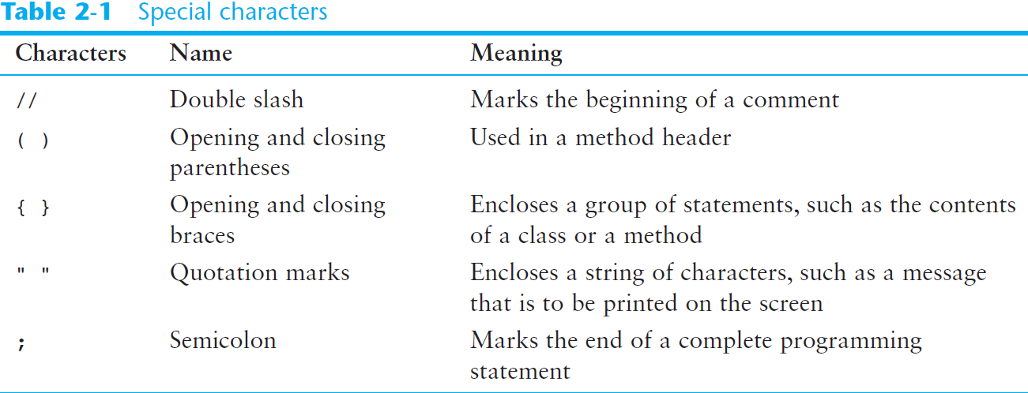
The Parts of a Java Program (cont’d.)

Slide 15
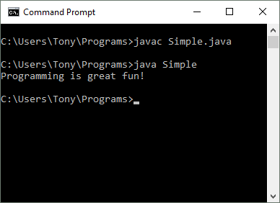
The System.out.print and System.out.println Methods, and the Java API
Many of the programs that you will write will run in a console window.

Slide 16
The System.out.print and System.out.println Methods, and the Java API (cont’d.)
The console window that starts a Java application is typically known as the standard output device.
The standard input device is typically the keyboard.
Java sends information to the standard output device by using a Java class stored in the standard Java library.

Slide 17
The System.out.print and System.out.println Methods, and the Java API (cont’d.)
Java classes in the standard Java library are accessed using the Java Applications Programming Interface (API).
The standard Java library is commonly referred to as the Java API.

Slide 18
The System.out.print and System.out.println Methods, and the Java API (cont’d.)
The previous example uses the line:
  System.out.println("Programming is great fun!");
This line uses the System class from the standard Java library.
The System class contains methods and objects that perform system level tasks.
The out object, a member of the System class, contains the methods print and println.

Slide 19
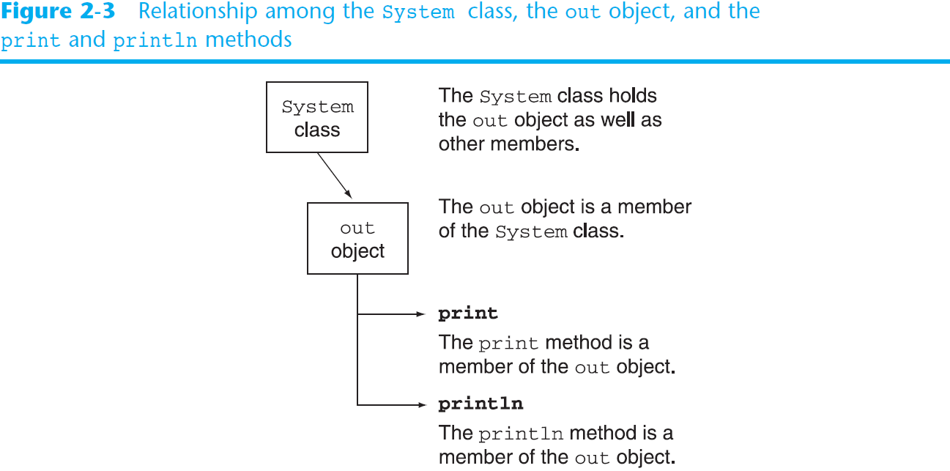
The System.out.print and System.out.println Methods, and the Java API (cont’d.)

Slide 20
The System.out.print and System.out.println Methods, and the Java API (cont’d.)
The print and println methods actually perform the task of sending characters to the output device.
The line:
  System.out.println("Programming is great fun!");
  is pronounced: “system dot out dot print line”
The value inside the parenthesis, called an argument, will be sent to the output device (in this case, a string).

Slide 21
The System.out.print and System.out.println Methods, and the Java API (cont’d.)
The println method places a newline character at the end of whatever is being printed out.
  The following lines:
    System.out.println("This is being printed out");
    System.out.println("on two separate lines.");
  Would be printed out on separate lines since the first statement sends a newline command to the screen.

Slide 22
The System.out.print and System.out.println Methods, and the Java API (cont’d.)
The print statement works very similarly to the println statement.
However, the print statement does not put a newline character at the end of the output.
The lines:
    System.out.print("These lines will be");
    System.out.print("printed on");
    System.out.println("the same line.");
  Produce the following output:
  These lines will beprinted onthe same line.
  Notice the odd spacing?
  Why do some words run together?

Slide 23
The System.out.print and System.out.println Methods, and the Java API (cont’d.)
For all of the previous examples, we have been printing out strings of characters.
Later, we will see that much more can be printed.
There are some special characters that can be put into the output.
System.out.print("This will have a newline.\n");
The \n in the string is an escape sequence that represents the newline character.
Escape sequences allow the programmer to print characters that otherwise would be unprintable.

Slide 24
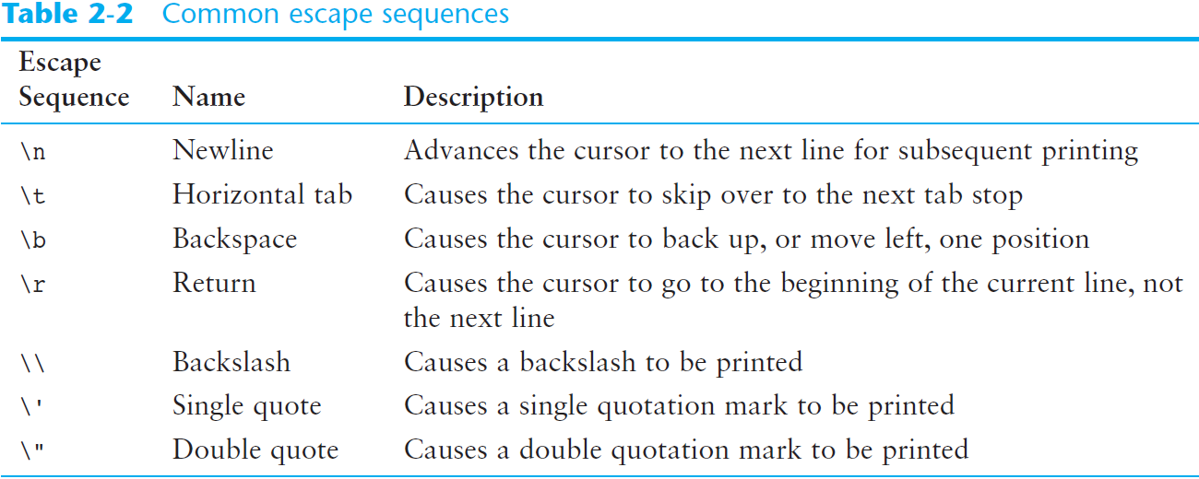
The System.out.print and System.out.println Methods, and the Java API (cont’d.)

Slide 25
The System.out.print and System.out.println Methods, and the Java API (cont’d.)
Even though the escape sequences are comprised of two characters, they are treated by the compiler as a single character.
    System.out.print("These are our top sellers:\n");
    System.out.print("\tComputer games\n\tCoffee\n ");
    System.out.println("\tAspirin");
Would result in the following output:
These are our top sellers:
Computer games
Coffee
Asprin
With escape sequences, complex text output can be achieved.

Slide 26
Variables and Literals
A variable is a named storage location in the computer’s memory.
A literal is a value that is written into the code of a program.
Programmers determine the number and type of variables a program will need.

Slide 27
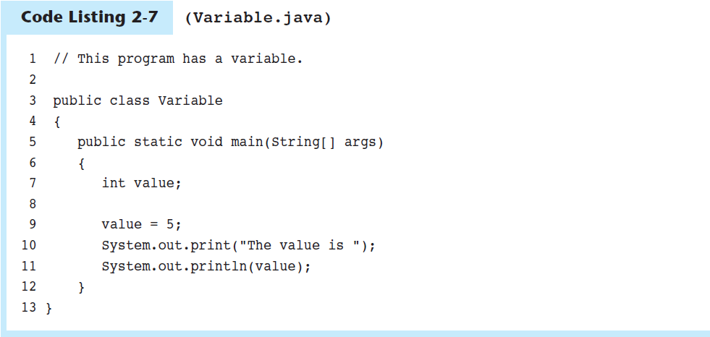
Variables and Literals (cont’d.)
Line 7 contains a variable declaration.
Variables must be declared before they are used.
A variable declaration tells the compiler the variable’s name and the type of data it will hold.
This variable’s name is value, and the word int means that it will hold an integer value.
Notice that variable declarations end with a semicolon.
Variable Declaration

Slide 28
Variables and Literals (cont’d.)
Line 9 contains an assignment statement.
The equal sign is an operator that stores the value on its right (in this case 5) into the variable named on its left.
After this line executes, the value variable will contain the value 5.
  Line 9 doesn’t print anything. It runs silently behind the scenes.
Assignment Statement

Slide 29
Variables and Literals (cont’d.)
Line 10 sends the string literal "The value is " to the print method.
Line 11 send the name of the value variable to the println method.
When you send a variable name to print or println, the variable’s contents are displayed.
  Notice there are no quotation marks around the variable value.
Display String Literal
Display Variable’s Contents

Slide 30
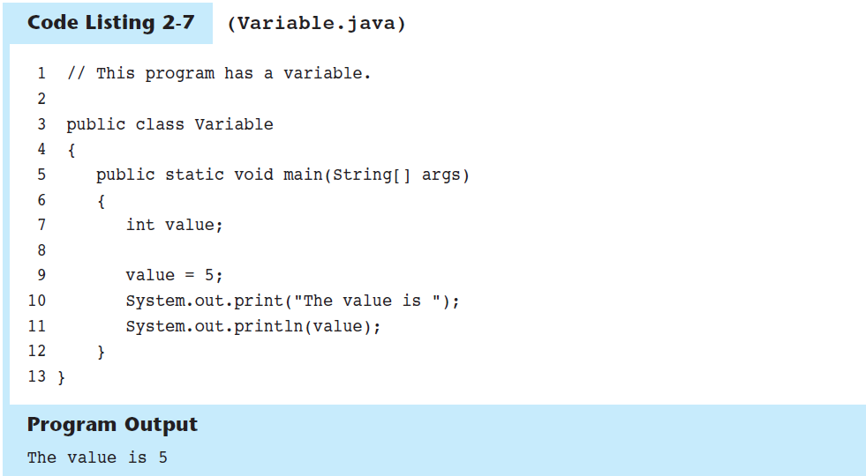
Variables and Literals (cont’d.)

Slide 31
Displaying Multiple Items with the + Operator
The + operator can be used in two ways.
  as a concatenation operator
  as an addition operator
If either side of the + operator is a string, the result will be a string.
  System.out.println("Hello " + "World");
  System.out.println("The value is: " + 5);
  System.out.println("The value is: " + value);
  System.out.println("The value is: " + '/n' + 5);

Slide 32
String Concatenation
Java commands that have string literals must be treated with care.
A string literal value cannot span lines in a Java source code file.
  System.out.println("This line is too long and now it has spanned more than one line, which will cause a syntax error to be generated by the compiler. ");

Slide 33
String Concatenation (cont’d.)
The String concatenation operator can be used to fix this problem.
    System.out.println("These lines are " +
    "now ok and will not " +
    "cause the error as before.");
String concatenation can join various data types.
    System.out.println("We can join a string to " +
    "a number like this: " + 5);

Slide 34
String Concatenation (cont’d.)
The Concatenation operator can be used to format complex String objects.
    System.out.println("The following will be printed " +
    "in a tabbed format: " +
    "\n\tFirst = " + 5 * 6 + ", " +
    "\n\tSecond = " + (6 + 4) + "," +
    "\n\tThird = " + 16.7 + ".");
Notice that if an addition operation is also needed, it must be put in parenthesis.

Slide 35
Identifiers
Identifiers are programmer-defined names for:
  classes
  variables
  methods
Identifiers may not be any of the Java reserved key words.

Slide 36
Identifiers (cont’d.)
Identifiers must follow certain rules:
  An identifier may only contain:
    letters a–z or A–Z,
    the digits 0–9,
    underscores ( _ ), or
    the dollar sign ( $ )
  The first character may not be a digit.
  Identifiers are case sensitive.
    itemsOrdered is not the same as itemsordered.
  Identifiers cannot include spaces.

Slide 37
Class Names
Variable names should begin with a lower case letter and then capitalize the first letter of each word thereafter:
    Ex: int caTaxRate
Class names should begin with a capital letter and each word thereafter should be capitalized.
    Ex: public class BigLittle
This helps differentiate the names of variables from the names of classes.

Slide 38
Primitive Data Types
Primitive data types are built into the Java language and are not derived from classes.
There are 8 Java primitive data types.
  byte
  short
  int
  long
  float
  double
  boolean
  char

Slide 39
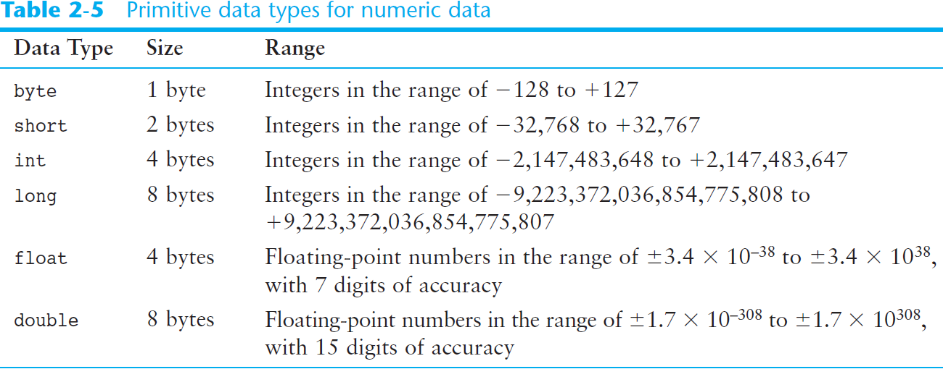
Numeric Data Types

Slide 40
Variable Declarations
Variable Declarations take the following form:
  DataType VariableName;
    byte inches;
    short month;
    int speed;
    long timeStamp;
    float salesCommission;
    double distance;

Slide 41
Integer Data Types
byte, short, int, and long are all integer data types.
They can hold whole numbers such as 5, 10, 23, 89, etc.
Integer data types cannot hold numbers that have a decimal point in them.
Integers embedded into Java source code are called integer literals.

Slide 42
Floating-Point Data Types
Data types that allow fractional values are called floating-point numbers.
  1.7 and -45.316 are floating-point numbers.
In Java there are two data types that can represent floating-point numbers.
  float - also called single precision
    (7 decimal points)
  double - also called double precision
    (15 decimal points)

Slide 43
Floating-Point Literals
When floating-point numbers are embedded into Java source code they are called floating-point literals.
The default data type for floating-point literals is double.
  29.75, 1.76, and 31.51 are double data types.
Java is a strongly-typed language

Slide 44
Floating-Point Literals (cont’d.)
Literals cannot contain embedded currency symbols or commas.
  grossPay = $1,257.00; // ERROR!
  grossPay = 1257.00; // Correct.
Floating-point literals can be represented in scientific notation.
  47,281.97 == 4.728197 x 10⁴.
Java uses E notation to represent values in scientific notation.
  4.728197X10⁴ == 4.728197E4.

Slide 45
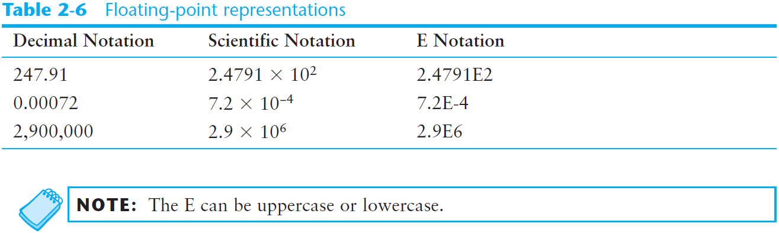
Scientific and E Notation

Slide 46
The boolean Data Type
The Java boolean data type can have two possible values.
  true
  false
The value of a boolean variable may only be copied into a boolean variable.

Slide 47
The char Data Type
The Java char data type provides access to single characters.
char literals are enclosed in single quote marks.
  'a', 'Z', '\n', '1'
Don’t confuse char literals with string literals.
  char literals are enclosed in single quotes.
  String literals are enclosed in double quotes.

Slide 48
Unicode
Internally, characters are stored as numbers.
Character data in Java is stored as Unicode characters.
The Unicode character set can consist of 65536 (2¹⁶) individual characters.
This means that each character takes up 2 bytes in memory.
The first 256 characters in the Unicode character set are compatible with the ASCII* character set.
*American Standard Code for Information Interchange

Slide 49
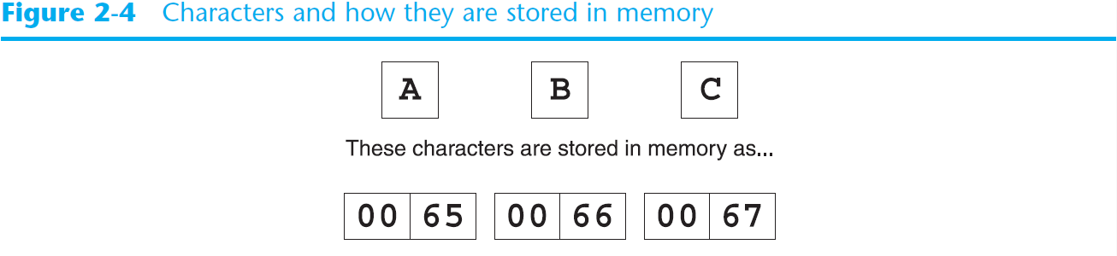
Unicode (cont’d.)

Slide 50
Variable Assignment and Initialization
In order to store a value in a variable, an assignment statement must be used.
The assignment operator is the equal (=) sign.
The operand on the left side of the assignment operator must be a variable name.
The operand on the right side must be either a literal or expression that evaluates to a type that is compatible with the type of the variable.

Slide 51
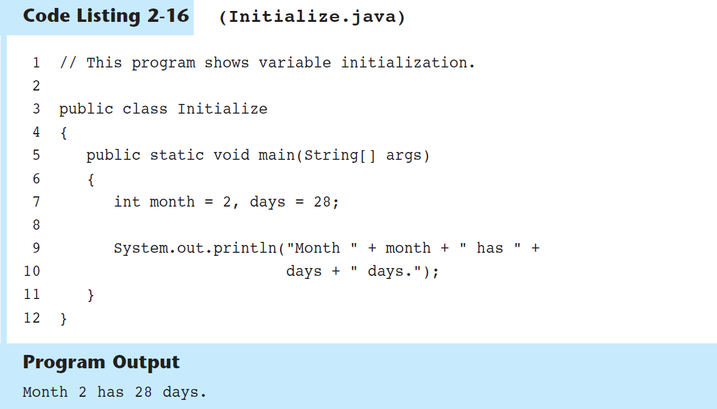

Slide 52
Variable Assignment and Initialization (cont’d.)
Variables can only hold one value at a time.
Local variables do not receive a default value.
Local variables must have a valid type in order to be used.

Slide 53
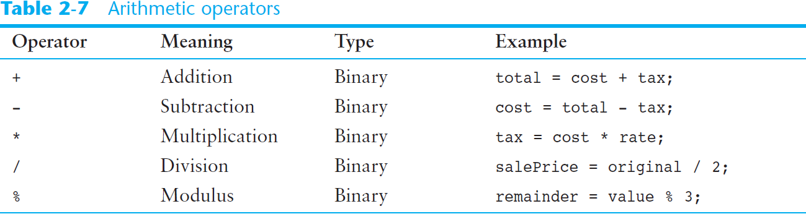
Arithmetic Operators

Slide 54
Arithmetic Operators (cont’d.)
The operators are called binary operators because they must have two operands.
Each operator must have a left and right operand.
The arithmetic operators work as one would expect.
It is an error to try to divide any number by zero.
When working with two integer operands, the division operator requires special attention.

Slide 55
Integer Division
Division can be tricky.
  In a Java program, what is the value of 1/2?
You might think the answer is 0.5…
But, that’s wrong.
The answer is simply 0.
Integer division will truncate any decimal remainder.

Slide 56
Operator Precedence
Mathematical expressions can be very complex.
There is a set order in which arithmetic operations will be carried out.
Operator | Associativity | Example | Result
- (unary negation) | right to left | x = -4 + 3; | -1
* / % | left to right | x = -4 + 4 % 3 * 13 + 2; | 11
+ - | left to right | x = 6 + 3 – 4 + 6 * 3; | 23
Higher
Priority
Lower
Priority

Slide 57
Grouping with Parenthesis
When parenthesis are used in an expression, the inner most parenthesis are processed first.
If two sets of parenthesis are at the same level, they are processed left to right.
x = ((4*5) / (5-2) ) – 25; // result = -19
3
1
2
4

Slide 58
The Math Class
The Java API provides a class named Math, which contains several methods that are useful for performing complex mathematical operations.
  In Java, raising a number to a power requires the Math.pow method
    double result = math.pow(4.0, 2.0);
  The Math.sqrt method accepts a double value as its argument and returns the square root of the value
  double result = math.sqrt(9.0);

Slide 59
Combined Assignment Operators
Java has some combined assignment operators.
These operators allow the programmer to perform an arithmetic operation and assignment with a single operator.
Although not required, these operators are popular since they shorten simple equations.

Slide 60
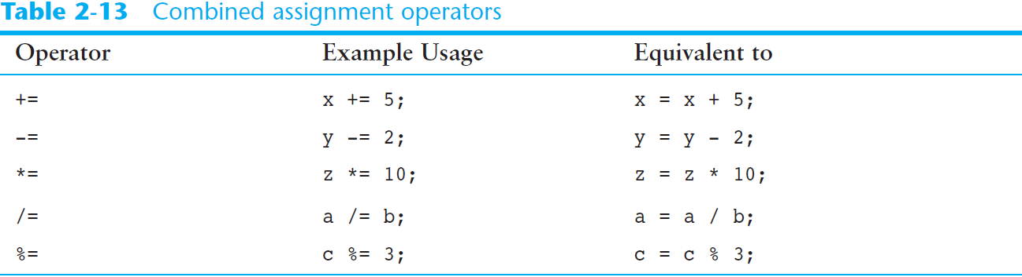
Combined Assignment Operators (cont’d.)

Slide 61
Conversion between Primitive Data Types
Java is a strongly typed language.
  Before a value is assigned to a variable, Java checks the data types of the variable and the value being assigned to it to determine if they are compatible.
  When you try to assign an incompatible value to a variable, an error occurs at compile-time.

Slide 62
Conversion between Primitive Data Types (cont’d.)
For example, look at the following statements:
int x;
double y = 2.5;
x = y;
This statement will cause a compiler error because it is trying to assign a double value (2.5) in an int variable.

Slide 63

Conversion between Primitive Data Types (cont’d.)
The Java primitive data types are ranked, as shown here:

Slide 64
Conversion between Primitive Data Types (cont’d.)
Widening conversions are allowed.
  This is when a value of a lower-ranked data type is assigned to a variable of a higher-ranked data type.
Example:
double x;
int y = 10;
x = y;
Widening Conversion

Slide 65
Conversion between Primitive Data Types (cont’d.)
Narrowing conversions are not allowed.
  This is when a value of a higher-ranked data type is assigned to a variable of a lower-ranked data type.
Example:
int x;
double y = 2.5;
x = y;
Narrowing Conversion

Slide 66
Conversion between Primitive Data Types (cont’d.)
Cast Operators
  Let you manually convert a value, even if it means that a narrowing conversion will take place.
Example:
int x;
double y = 2.5;
x = (int)y;
Cast Operator

Slide 67
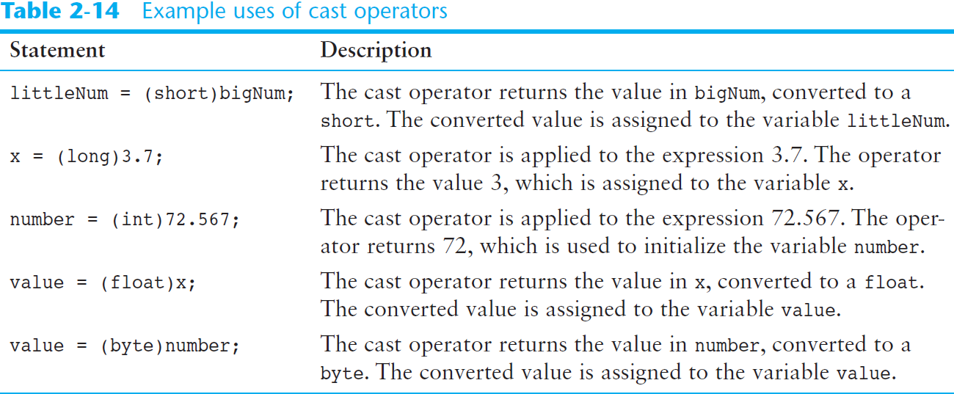
Conversion between Primitive Data Types (cont’d.)

Slide 68
Conversion between Primitive Data Types (cont’d.)
Mixed Integer Operations
  When values of the byte or short data types are used in arithmetic expressions, they are temporarily converted to int values.
  The result of an arithmetic operation using only a mixture of byte, short, or int values will always be an int.

Slide 69
Conversion between Primitive Data Types (cont’d.)
Mixed Integer Operations
  For example:
short a;
short b = 3;
short c = 7;
a = b + c;
a = (short)(b + c);
This statement will cause an error because the result of b + c is an int. It cannot be assigned to a short variable.
To fix the statement, rewrite the
expression using a cast operator.

Slide 70
Conversion between Primitive Data Types (cont’d.)
Other Mixed Mathematical Expressions
  If one of an operator’s operands is a double, the value of the other operand will be converted to a double.
  The result of the expression will be a double.
  If one of an operator’s operands is a float, the value of the other operand will be converted to a float.
  The result of the expression will be a float.
  If one of an operator’s operands is a long, the value of the other operand will be converted to a long.
  The result of the expression will be a long.

Slide 71
Creating Named Constants with final
Many programs have data that does not need to be changed.
Littering programs with literal values can make the program hard do read and maintain.
Replacing literal values with constants remedies this problem.
Constants allow the programmer to use a name rather than a value throughout the program.
Constants also give a singular point for changing those values when needed.

Slide 72
Creating Named Constants with final (cont’d.)
Constants keep the program organized and easier to maintain.
Constants are identifiers that can hold only a single value.
Constants are declared using the keyword final.
Constants need not be initialized when declared; however, they must be initialized before they are used or a compiler error will be generated.

Slide 73
Creating Named Constants with final (cont’d.)
Once initialized with a value, constants cannot be changed programmatically.
By convention, constants are all upper case and words are separated by the underscore character.
For example:
  final double CAL_SALES_TAX = 0.0725;

Slide 74
The String Class
Java has no primitive data type that holds a series of characters.
The String class from the Java standard library is used for this purpose.
In order to be useful, the a variable must be created to reference a String object.
  String number;
Notice the S in String is upper case.
By convention, class names should always begin with an upper case character.

Slide 75
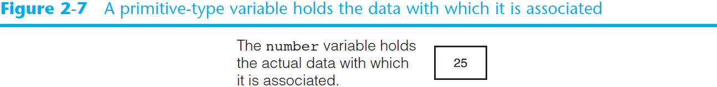
Primitive-Type Variables and Class-Type Variables
Primitive variables actually contain the value that they have been assigned.
  number = 25;
The value 25 will be stored in the memory location associated with the variable number.
Objects are not stored in variables, however. Objects are referenced by variables.

Slide 76
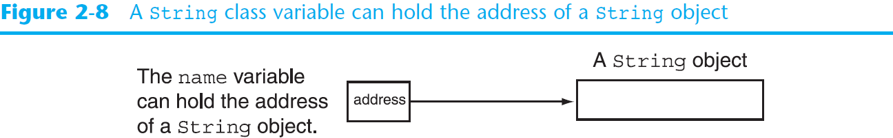
Primitive-Type Variables and Class-Type Variables (cont’d.)
When a variable references an object, it contains the memory address of the object’s location.
Then it is said that the variable references the object.
  String name = "Joe Mahoney";

Slide 77
Creating a String Object
A variable can be assigned a string literal.
  String value = "Hello";
String objects are the only objects that can be created in this way.
A variable can be created using the new keyword.
  String value = new String("Hello");
This is the method that all other objects must use when they are created.

Slide 78
Creating a String Object (cont’d.)
Since String is a class, objects that are instances of it have methods.
One of those methods is the length method.
  stringSize = value.length();
This statement calls the length method on the object pointed to by the value variable

Slide 79
Creating a String Object (cont’d.)
The String class contains many methods that help with the manipulation of String objects.
String objects are immutable, meaning that they cannot be changed.
Many of the methods of a String object can create new versions of the object.

Slide 80
Scope
Scope refers to the part of a program that has access to a variable’s contents.
Variables declared inside a method (like the main method) are called local variables.
The scope of a local variable begins at the declaration of the variable and ends at the end of the method in which it was declared.

Slide 81
Comments
Comments are:
  notes of explanation that document lines or sections of a program.
  part of the program, but the compiler ignores them.
  intended for people who may be reading the source code.
In Java, there are three types of comments:
  Single-line comments
  Multiline comments
  Documentation comments

Slide 82
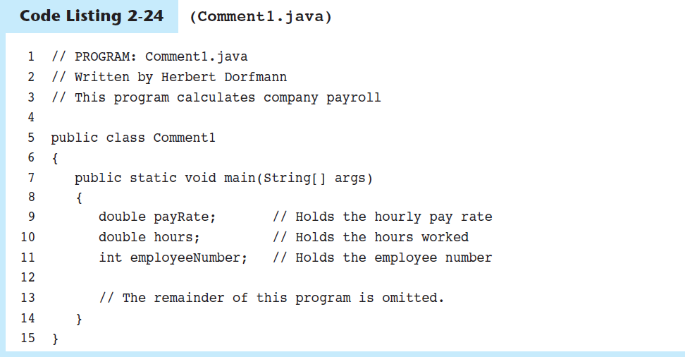
Single-Line Comments
Place two forward slashes (//) where you want the comment to begin.
  The compiler ignores everything from that point to the end of the line.

Slide 83
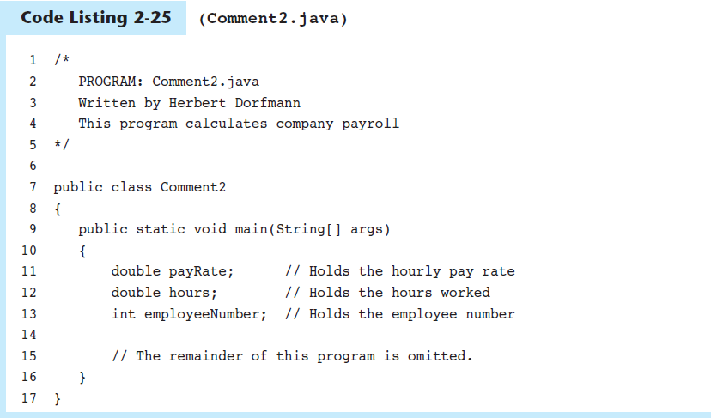
Multiline Comments
Start with /* (a forward slash followed by an asterisk) and end with */ (an asterisk followed by a forward slash).
  Everything between these markers is ignored.
  Can span multiple lines

Slide 84
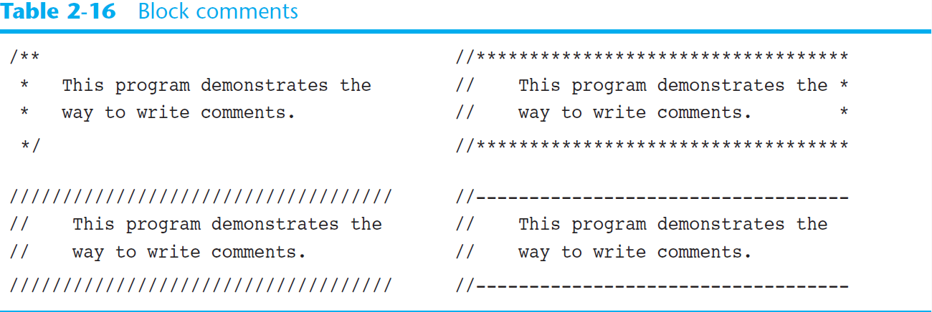
Block Comments
Many programmers use asterisks or other characters to draw borders or boxes around their comments.
This helps to visually separate the comments from surrounding code.

Slide 85
Documentation Comments
Any comment that starts with /** and ends with */ is considered a documentation comment.
You write a documentation comment just before:
  a class header, giving a brief description of the class.
  each method header, giving a brief description of the method.
Documentation comments can be read and processed by a program named javadoc, which comes with the Sun JDK.

Slide 86
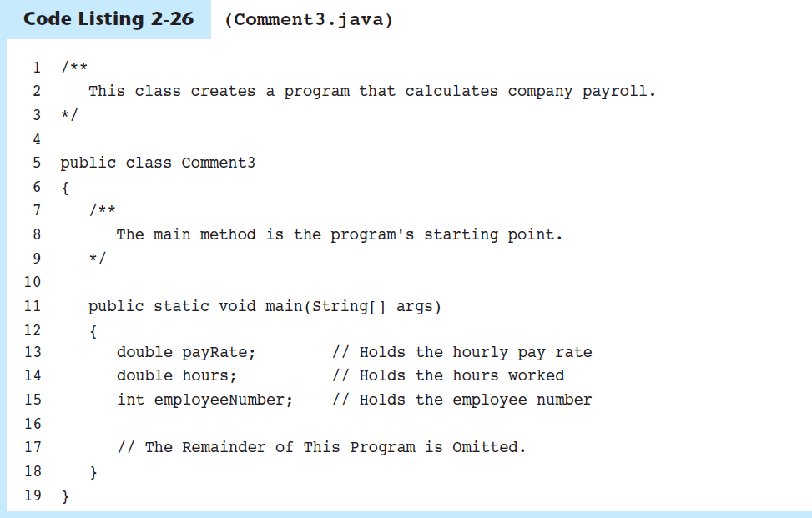
Documentation Comments (cont’d.)

Slide 87
Documentation Comments (cont’d.)
The purpose of the javadoc program is to read Java source code files and generate attractively formatted HTML files that document the source code.
To create the documentation, run the javadoc program with the source file as an argument.
  For example:
  javadoc Comment3.java
The javadoc program will create index.html and several other documentation files in the same directory as the input file

Slide 88
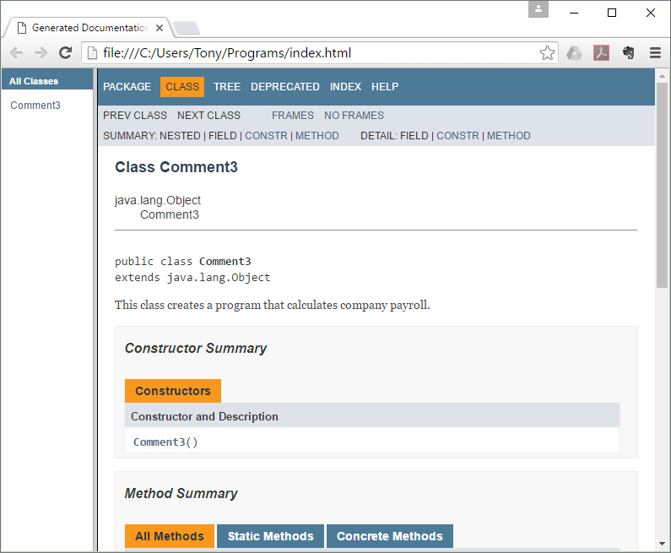
Documentation Comments (cont’d.)

Slide 89
Programming Style
Programming style refers to the way a programmer visually arranges a program’s source code.
When the compiler reads a program it:
  Processes it as one long stream of characters.
  Doesn’t care that each statement is on a separate line, or that spaces separate operators from operands.
  Humans, on the other hand, find it difficult to read programs that aren’t written in a visually pleasing manner.

Slide 90
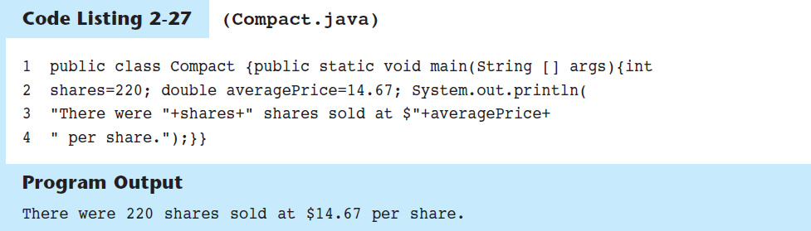
Programming Style (cont’d.)

Slide 91
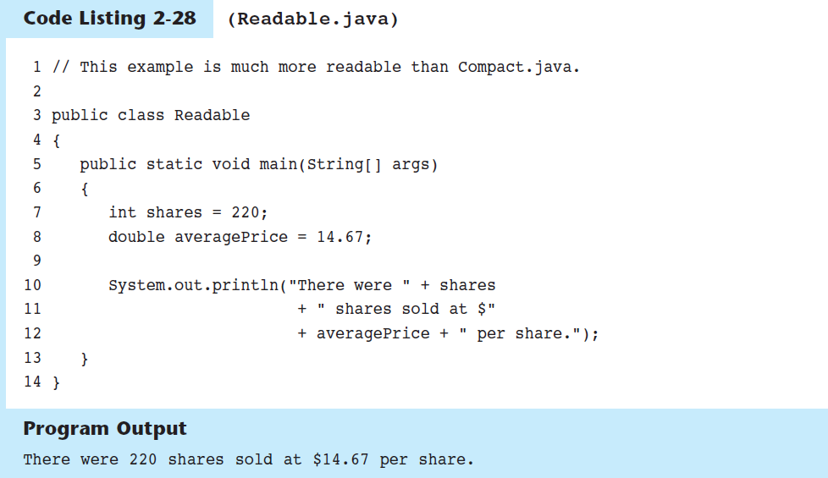
Programming Style (cont’d.)

Slide 92
Reading Keyboard Input
To read input from the keyboard we can use the Scanner class.
The Scanner class is defined in java.util, so we will use the following statement at the top of our programs:
import java.util.Scanner;

Slide 93
Reading Keyboard Input (cont’d.)
Scanner objects work with System.in
To create a Scanner object and connect it to the System.in object:
Scanner keyboard = new Scanner (System.in);

Slide 94
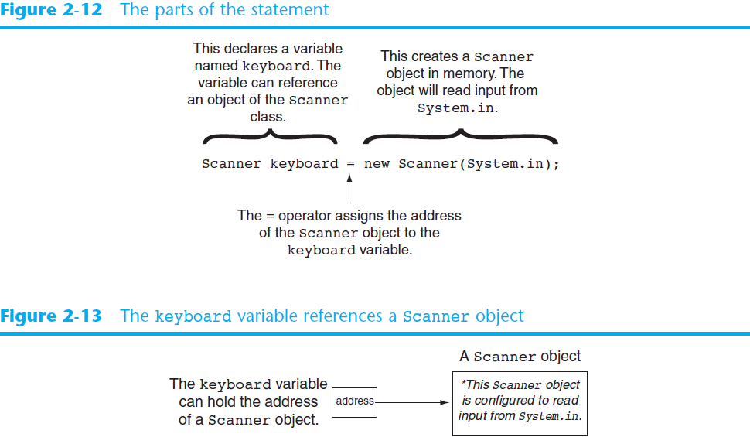

Slide 95
Reading Keyboard Input (cont’d.)
The Scanner class has methods for reading:
  strings using the nextLine method
  bytes using the nextByte method
  integers using the nextInt method
  long integers using the nextLong method
  short integers using the nextShort method
  floats using the nextFloat method
  doubles using the nextDouble method

Slide 96
Reading a Character
The Scanner class does not have a method for reading a single character.
  Use the Scanner class’s nextLine method to read a string from the keyboard.
  Then use the String class’s charAt method to extract the first character of the string.

Slide 97
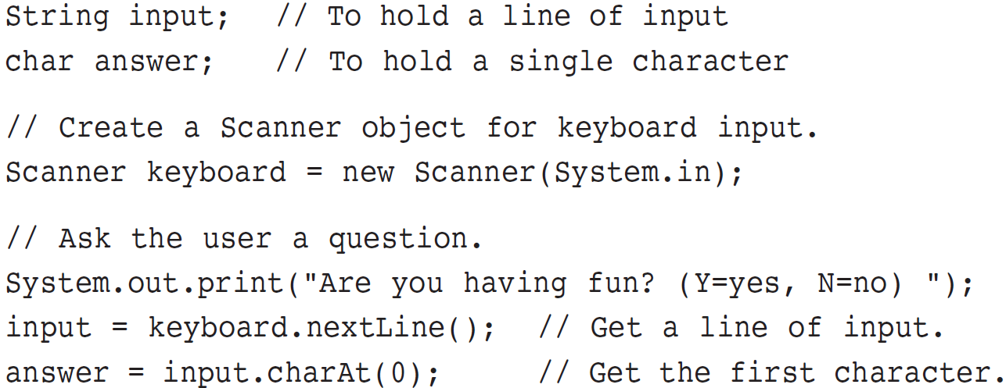
Reading a Character (cont’d.)

Slide 98
Mixing Calls to nextLine with Calls to Other
Scanner Methods
Keystrokes are stored in an area of memory that is sometimes called the keyboard buffer.
Pressing the Enter key causes a newline character to be stored in the keyboard buffer.
The Scanner methods that are designed to read primitive values, such as nextInt and nextDouble, will ignore the newline and return only the numeric value.
The Scanner class’s nextLine method will read the newline that is left over in the keyboard buffer, return it, and terminate without reading the intended input.

Slide 99
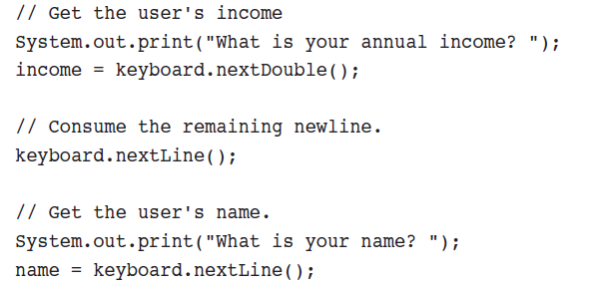
Mixing Calls to nextLine with Calls to Other
Scanner Methods (cont’d.)
Remove the newline from the keyboard buffer by calling the Scanner class’s nextLine method, ignoring the return value.
Read Primitive
Remove Newline
Read String

Slide 100
Dialog Boxes
A dialog box is a small graphical window that displays a message to the user or requests input.
A variety of dialog boxes can be displayed using the JOptionPane class.
Two of the dialog boxes are:
  Message Dialog - a dialog box that displays a message.
  Input Dialog - a dialog box that prompts the user for input.

Slide 101
Dialog Boxes (cont’d.)
The JOptionPane class is not automatically available to your Java programs.
The following statement must appear before the program’s class header:
  import javax.swing.JOptionPane;
This statement tells the compiler where to find the JOptionPane class.

Slide 102
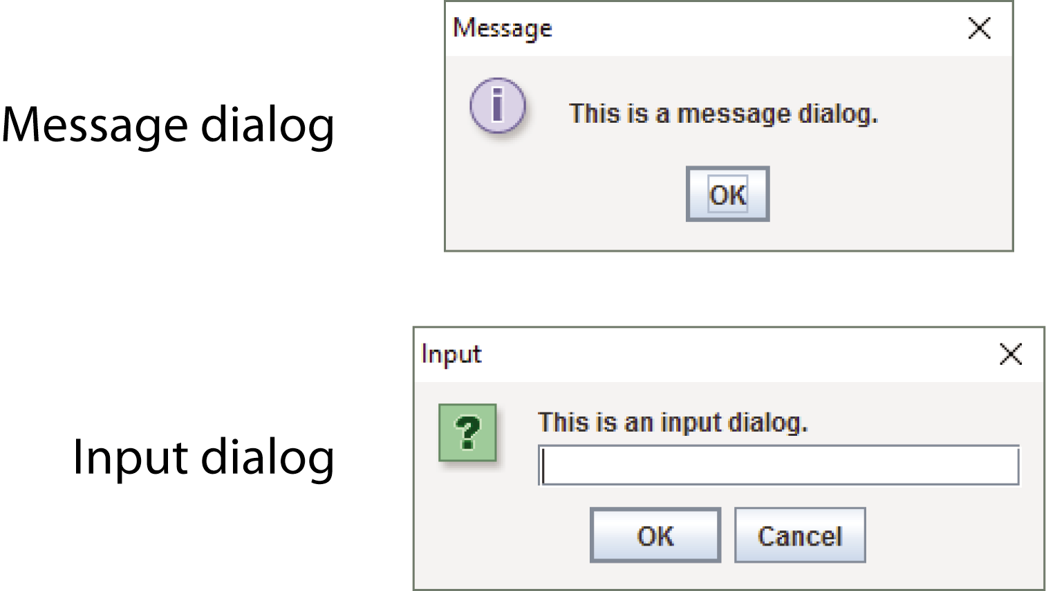
Dialog Boxes (cont’d.)
The JOptionPane class provides methods to display each type of dialog box.

Slide 103
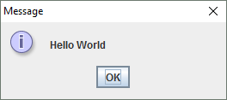
Displaying Message Dialogs
JOptionPane.showMessageDialog method is used to display a message dialog.
  JOptionPane.showMessageDialog(null, "Hello World");
  Use null as the first argument.
  The second argument is the message that is to be displayed.

Slide 104
Displaying Input Dialogs
An input dialog is a quick and simple way to ask the user to enter data.
The dialog displays a text field, an OK button and a Cancel button.
If OK is pressed, the dialog returns the user’s input.
If Cancel is pressed, the dialog returns null.

Slide 105
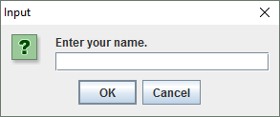
Displaying Input Dialogs (cont’d.)
  String name;
  name = JOptionPane.showInputDialog("Enter your name.");
  The argument passed to the method is the message to display.
  If the user clicks on the OK button, name references the string entered by the user.
  If the user clicks on the Cancel button, name references null.

Slide 106
Dialog Boxes (cont’d.)
A program that uses JOptionPane does not automatically stop executing when the end of the main method is reached.
Java generates a thread, which is a process running in the computer, when a JOptionPane is created.
If the System.exit method is not called, this thread continues to execute.

Slide 107
Dialog Boxes (cont’d.)
The System.exit method requires an integer argument.
  System.exit(0);
This argument is an exit code that is passed back to the operating system.
This code is usually ignored, however, it can be used outside the program:
  to indicate whether the program ended successfully or as the result of a failure.
  The value 0 traditionally indicates that the program ended successfully.

Slide 108
Converting a String to a Number
The JOptionPane’s showInputDialog method always returns the user's input as a String
A String containing a number, such as "127.89", can be converted to a numeric data type.

Slide 109
Converting a String to a Number (cont’d.)
Each of the numeric wrapper classes, (covered in Chapter 8) has a method that converts a string to a number.
  The Integer class has a method that converts a string to an int.
  The Double class has a method that converts a string to a double.
  etc.
These methods are known as parse methods because their names begin with the word “parse.”

Slide 110
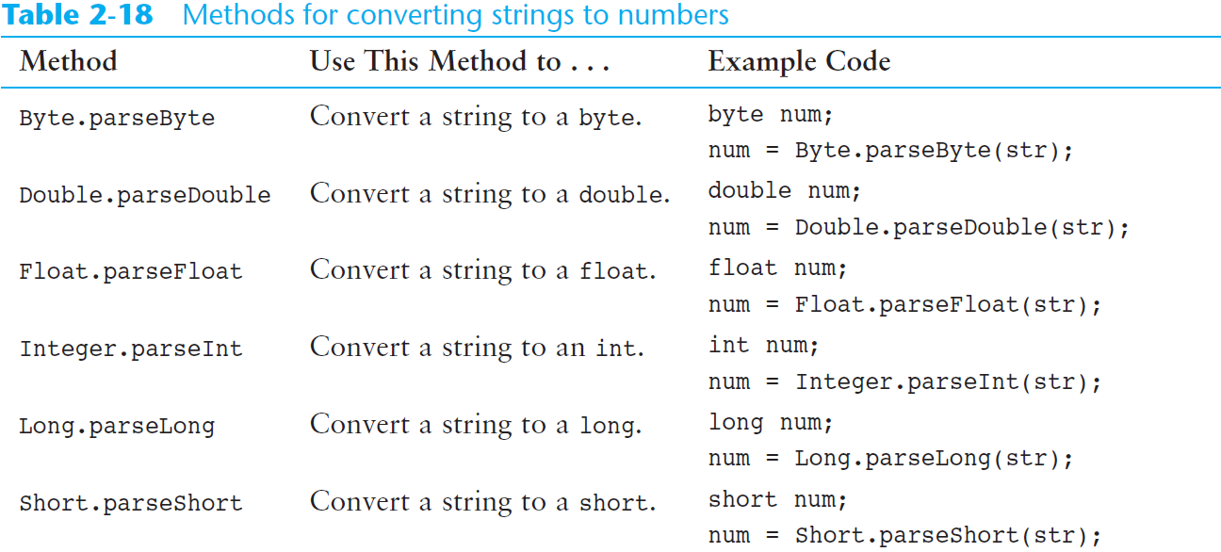
Converting a String to a Number (cont’d.)

Slide 111
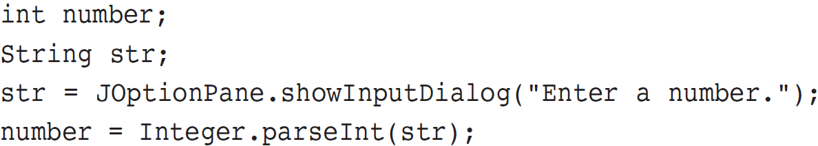
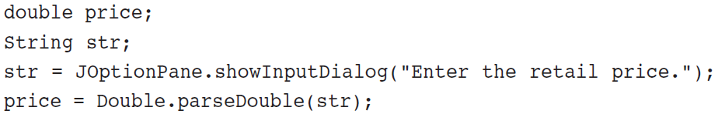
Converting a String to a Number (cont’d.)
Example conversion from string to int:
Example conversion from string to double:

Slide 112

The System.out.printf Method
You can perform formatted console output with the System.out.printf method.
The method’s general format is:
System.out.printf(FormatString, ArgumentList)
  FormatString is a string that contains text and/or special formatting specifiers
  ArgumentList is a list of zero or more additional arguments, formatted according to the format specifiers listed in the FormatString.
2-<number>

Slide 113
Simple Output
The simplest way you can use the printf method is with only a format string and no additional arguments.
System.out.printf("I love Java programming.\n");
This method call simply prints the string
I love Java programming.
Using the method without any format specifiers is like using the System.out.print method.

Slide 114
Single Format Specifier and Argument
Let’s look at an example that uses a format specifier and an additional argument:
int hours = 40;
System.out.printf("I worked %d hours this week.\n",hours);
When this string is printed, the value of the hours argument will be printed in place of the %d format specifier.
  I worked 40 hours this week.
The %d format specifier was used because the hours variable is an int.
An error will occur if you use %d with a non-integer value.

Slide 115
Multiple Format Specifiers and Arguments
Here’s another example:
int dogs = 2;
int cats = 4;
System.out.printf("We have %d dogs and %d cats.\n",dogs, cats);
First, notice that this example uses two %d format specifiers in the format string.
Also notice that two arguments appear after the format string.
  The value of the first integer argument, dogs, is printed in place of the first %d.
  The value of the second integer argument, cats, is printed in place of the second %d.
  We have 2 dogs and 4 cats.

Slide 116
Multiple Format Specifiers and Arguments
The following code shows another example:
int value1 = 3;
int value2 = 6;
int value3 = 9;
System.out.printf("%d %d %d\n", value1, value2, value3);
In the printf method call, there are three format specifiers and three additional arguments after the format string.
This code will produce the following output:
3 6 9
These examples show the one-to-one correspondence between the format specifiers and the arguments that appear after the format string.

Slide 117
Setting the Field Width
A format specifier may also include a field width. Here is an example:
int number = 9;
System.out.printf("The value is %6d\n", number);
The format specifier %6d indicates that the argument number should be printed in a field that is 6 places wide. If the value in number is shorter than 6 places, it will be right justified. Here is the output of the code.
The value is 9
If the value of the argument is wider than the specified field width, the field width will be expanded to accommodate the value.
1
2
3
4
5
6

Slide 118
Using Field Widths to Print Columns
Field widths can help when you need to print values aligned in columns. For example, look at the following code:
int num1 = 97654, num2 = 598;
int num3 = 86, num4 = 56012;
int num5 = 246, num6 = 2;
System.out.printf("%7d %7d\n", num1, num2);
System.out.printf("%7d %7d\n", num3, num4);
System.out.printf("%7d %7d\n", num5, num6);
This code displays the values of the variables in a table with three rows and two columns. Each column has a width of seven spaces. Here is the output for the code:
97654 598
86 56012
246 2
1
2
3
4
5
6
7
1
2
3
4
5
6
7

Slide 119
Printing Formatted Floating-Point Values
If you wish to print a floating-point value, use the %f format specifier. Here is an example:
double number = 1278.92;
System.out.printf("The number is %f\n", number);
This code produces the following output:
The number is 1278.920000
You can also use a field width when printing floating-point values. For example the following code prints the value of number in a field that is 18 spaces wide:
System.out.printf("The number is %18f\n", number);

Slide 120
Printing Formatted Floating-Point Values
In addition to the field width, you can also specify the number of digits that appear after the decimal point. Here is an example:
double grossPay = 874.12;
System.out.printf("Your pay is %.2f\n", grossPay);
In this code, the %.2f specifier indicates that the value should appear with two digits after the decimal point. The output of the code is:
Your pay is 874.12
1
2

Slide 121
Printing Formatted Floating-Point Values
When you specify the number of digits to appear after the decimal point, the number will be rounded. For example, look at the following code:
double number = 1278.92714;
System.out.printf("The number is %.2f\n", number);
This code will produce the following output:
The number is 1278.93

Slide 122
Printing Formatted Floating-Point Values
You can specify both the field width and the number of decimal places together, as shown here:
double grossPay = 874.12;
System.out.printf("Your pay is %8.2f\n", grossPay);
The output of the code is:
Your pay is 874.12
1
2
3
4
5
6
7
8
1
2

Slide 123
Printing Formatted Floating-Point Values
You can also use commas to group digits in a number. To do this, place a comma after the % symbol in the format specifier. Here is an example:
double grossPay = 1253874.12;
System.out.printf("Your pay is %,.2f\n", grossPay);
This code will produce the following output:
Your pay is 1,253,874.12

Slide 124
Printing Formatted String Values
If you wish to print a string argument, use the %s format specifier. Here is an example:
String name = "Ringo";
System.out.printf("Your name is %s\n", name);
This code produces the following output:
Your name is Ringo

Slide 125
Printing Formatted String Values
You can also use a field width when printing strings. For example, look at the following code:
String name1 = "George", name2 = "Franklin";
String name3 = "Jay", name4 = "Ozzy";
String name5 = "Carmine", name6 = "Dee";
System.out.printf("%10s %10s\n", name1, name2);
System.out.printf("%10s %10s\n", name3, name4);
System.out.printf("%10s %10s\n", name5, name6);
This code displays the values of the variables in a table with three rows and two columns. Each column has a width of ten spaces. Here is the output of the code:
George Franklin
Jay Ozzy
Carmine Dee

Slide 126
The String.format Method
The String.format method works exactly like the System.out.printf method, except that it does not display the formatted string on the screen.
Instead, it returns a reference to the formatted string.
You can assign the reference to a variable, and then use it later.

Slide 127
The String.format Method
The general format of the method is:
String.format(FormatString,ArgumentList);
FormatString is a string that contains text and/or special formatting specifiers.
ArgumentList is optional. It is a list of additional arguments that will be formatted according to the format specifiers listed in the format string.

Slide 128
The String.format Method
See examples:
  CurrencyFormat2.java
  CurrencyFormat3.java

